Slide 1
Ecomm site v2.0
By Benjamin sklar June 2017

Slide 2
Overview
Upgrade of e-comm website from Winter Quarter 2016/7
New features, webpages, and technology added.
Minimal changes to CSS styling and general HTML

Slide 3
Technology added
Maps, Leaflet/openstreetmap.org
jQuery
Handlebars templates
Client-Server communication via Amazon Web Services (AWS)
Cognito authentication/authorization
DynamoDB NoSql database

Slide 4
Features added
Location page
User signin, user information page
Checkout page and order submission

Slide 5
AWS
Cognito service: provides user authentication and allows app to access AWS resources
DynamoDB, NoSQL databases. Tables:
ecomm-Products: Contains product information that is downloaded into local SessionStorage
ecomm-Orders: primary information for submitted orders
ecomm-OrderLines: detail information for submitted orders

Slide 6
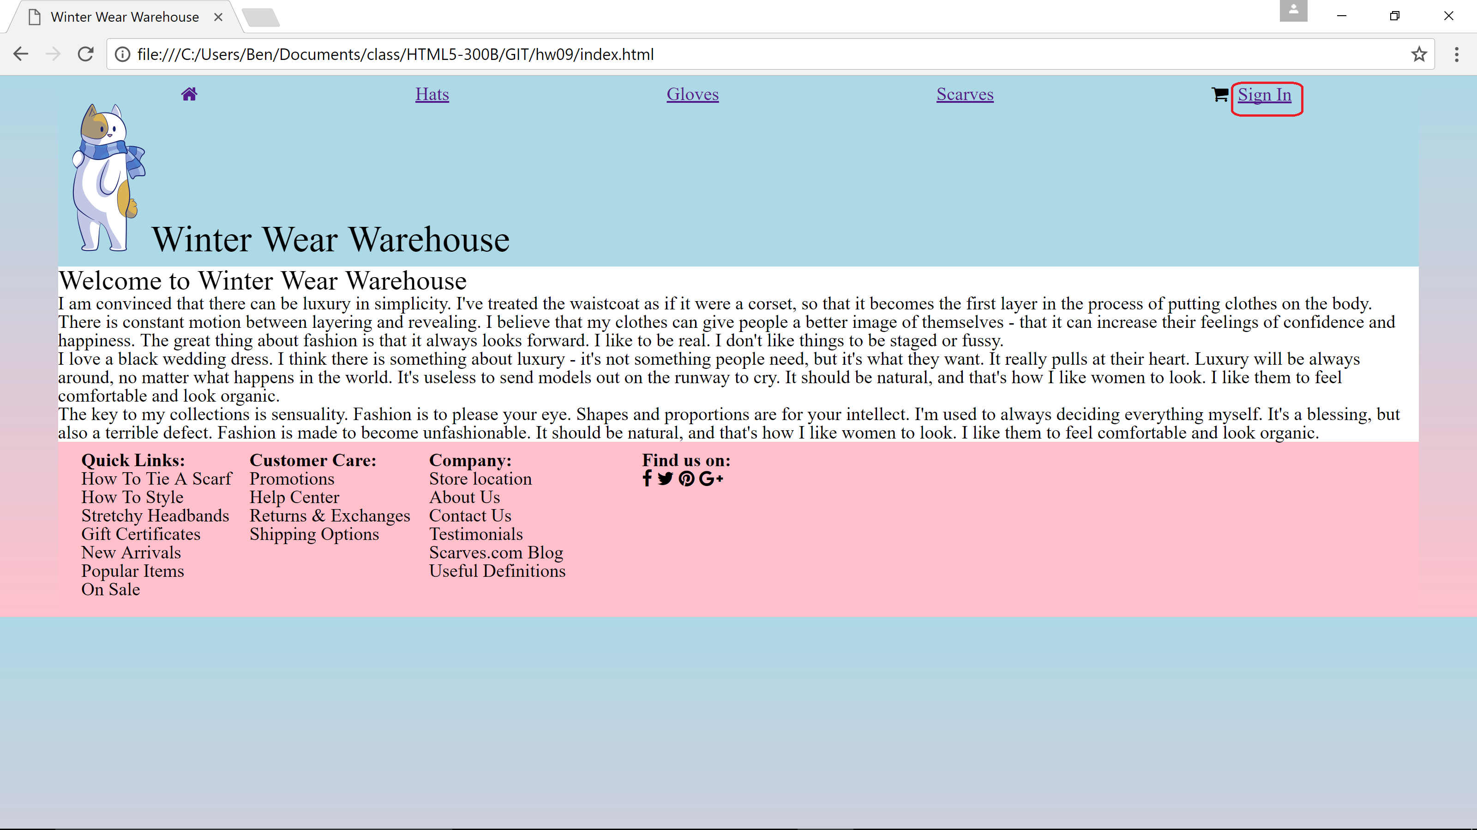
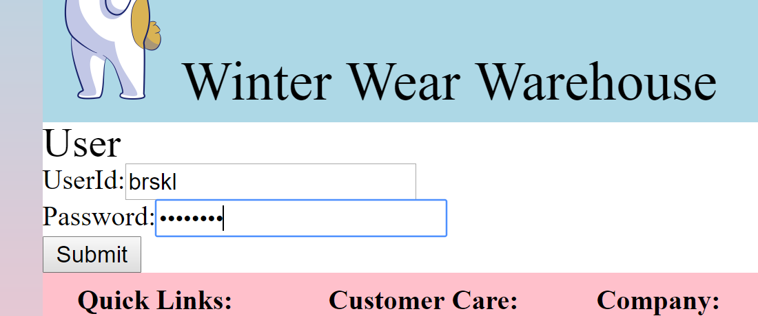
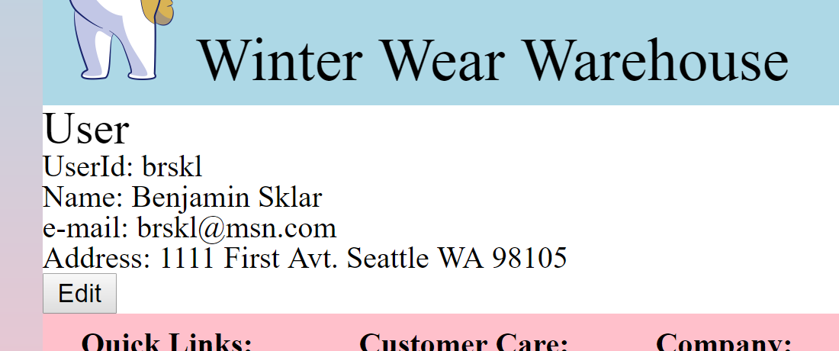
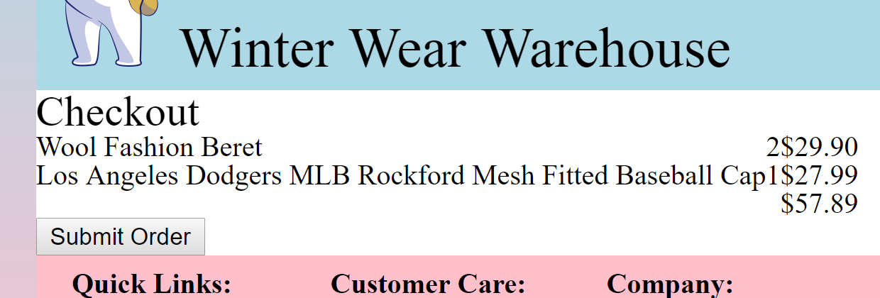
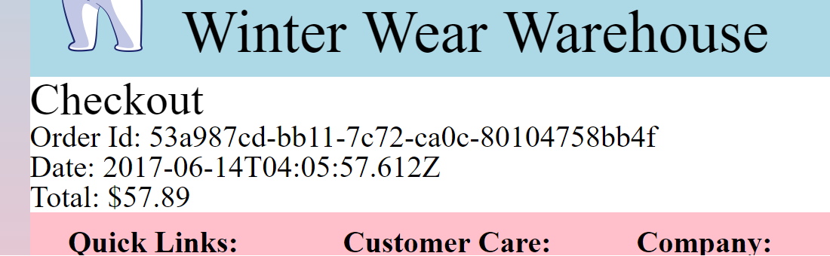

Slide 7
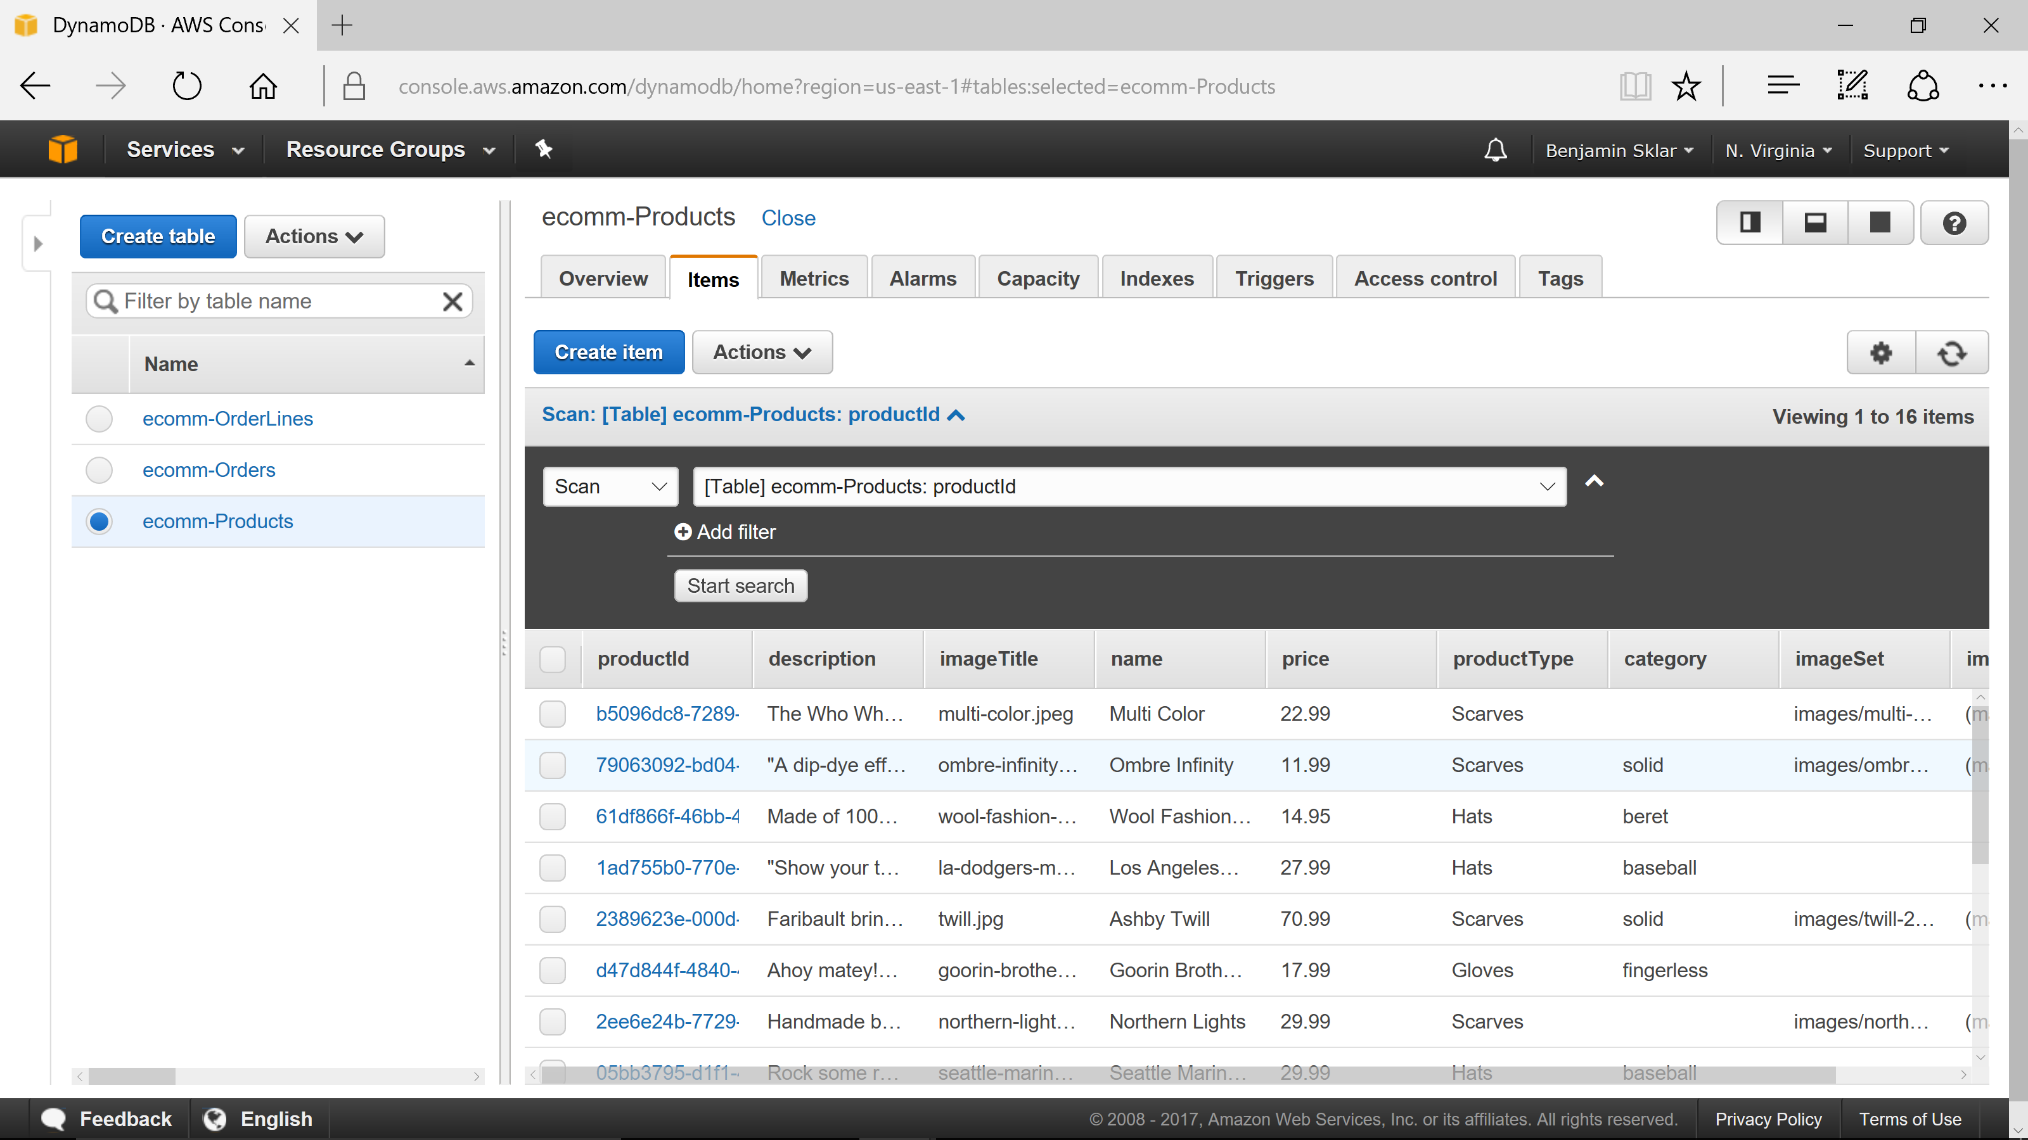
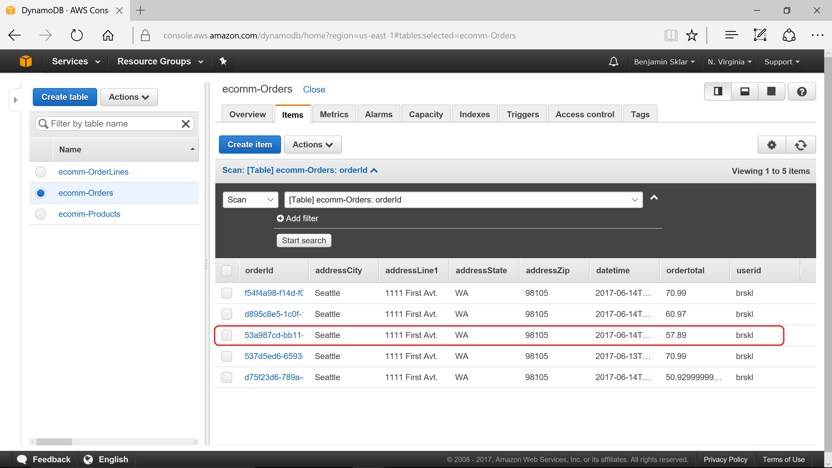
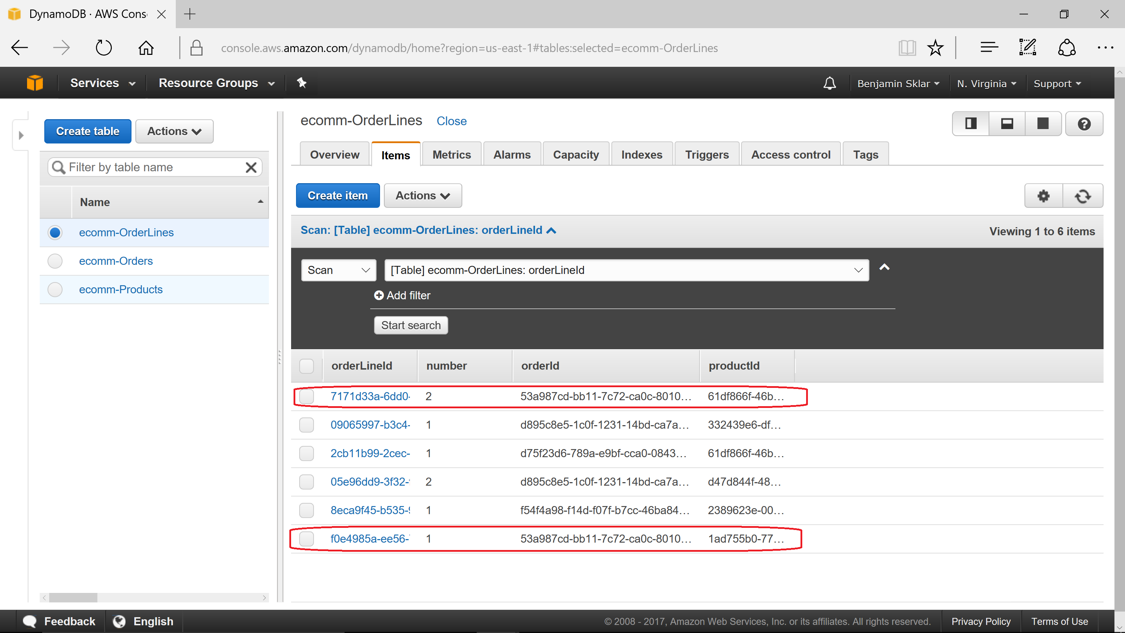

Slide 8
Future Improvements
More error checking
Modularize code using IIFE
Cleanup new HTML:
User signin/edit in user.html
Checkout info and submitted order in checkout.html
Additional user functionality: new user signup, forgot password, MFA, signin via 3rd party (Google+, Facebook, Amazon, etc.)
Additional Checkout functionality: shipping options, shipping address, tax based on address, payment info
Additional Order functionality: show past orders along with current status.
Use AWS ‘API Gateway’ instead of writing directly to DynamoDB tables so client input can be verified.

Slide 9
Links
Source: https://github.com/brskl/HTML5_300/tree/master/hw09
Website: https://brskl.github.io/HTML5_300/hw09/index.html
YouTube: https://youtu.be/kUtCMchC7Xo
This presentation: https://github.com/brskl/HTML5_300/blob/master/HTML5-300B%20presentation.pptx

